Slide 1


Scrapping for a Data Job
Natural Language Processing for an Efficient Job Search
Sia Seko
Aspiring Data Practitioner

Slide 2

It’s a job search! Tell me more…

Slide 3
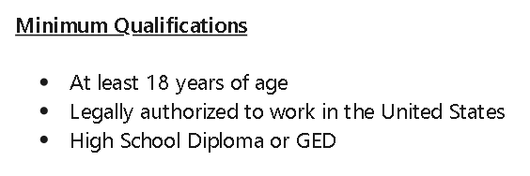


Not quite yet…
but immigration
Never mind, we can’t apply

Slide 4

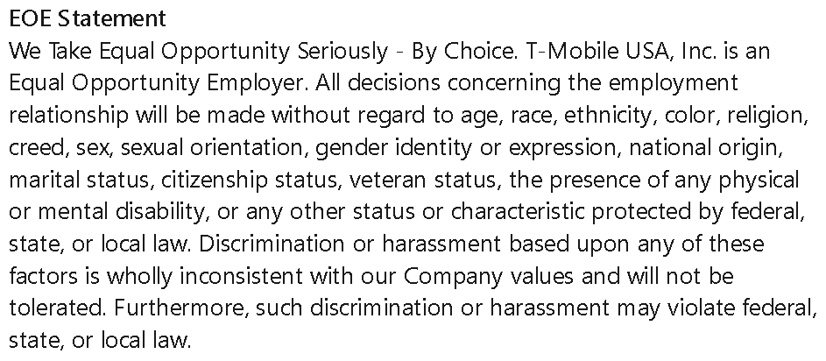

But wait, there’s hope!
citizenship status!!
ABC = ambiguity births confusion

Slide 5

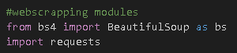

Scrape, scrape, scrape
Get the data
We only want to process the description

Slide 6

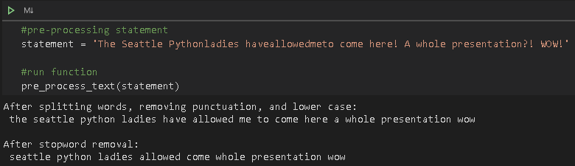

Natural Language Processing!
Pre-processing
Notes:
Libraries
String => contains punctuation model from which to compare the characters to remove
Wordninja => to split out bundled words. Will also account for words that are usually one e.g. tonight, roadmap
.lower() => string function to change text to lower case
“from nltk.corpus import stopwords” => to get all stopword corpus lists. For English, “stopwords.words(‘english’)

Slide 7


Tag, you’re it!
Citizenship status (EEO)
Visa assistance available
Sponsorship available
…
Active clearance required
No visa assistance
Must be a U.S. citizen
Must have work authorization

Slide 8

Modeling and next steps
Classification model improvement
Dimensionality reduction

Slide 9
Thank You ☺
Sia Seko
Twitter: @siawayforward
siawayforward.projects@gmail.com for collaborations ☺

